Slide 1
Unity Development
Interactive Media
Unit 1

Slide 2
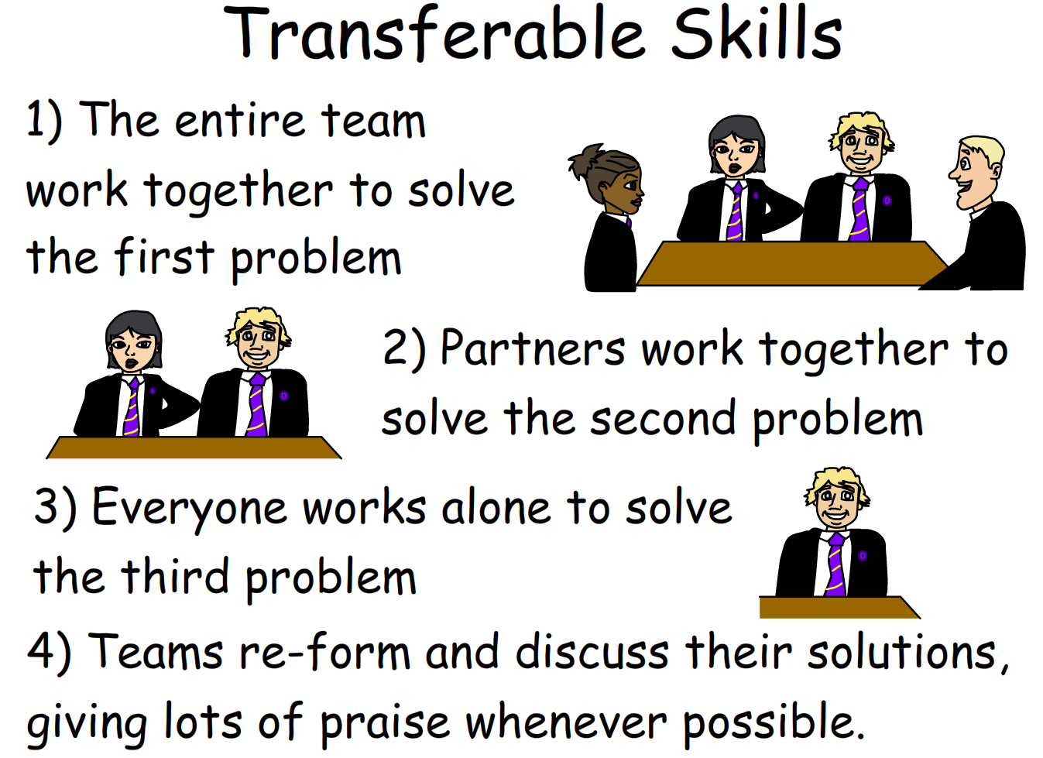
Starter – 5 Minutes
Log in and fill your answers into your worksheet.
List the skills you think are involved in the game development process.
Which of these skills do you think is the most important?
What methods can be used to ensure the project is done to the client’s requirements?

Slide 3

Learning Outcomes
Aspire to ……
 | Explain how to adapt and improve a game in Unity.
Challenge to……
 | Describe the different skills needed in the production process.
 | Understand the steps to take to produce a game in Unity.

Slide 4
How to Learn Unity
You will have access to a couple of tutorials that cover the basics of 2D and 3D games in Unity.
However, these only cover the basics of how to get the games working.
Also, they’re not particularly exciting games…
Learning how to do more with Unity will come later on in Unit 3, but there is nothing stopping you from practicing before then.

Slide 5
Using Unity
Unity is free to use if you are using it for personal use.
If you decide to sell a game or include an element where you are profiting from it, you need to make sure you have the correct rights to use everything within the game.
If your product becomes really successful, Unity requires that you give them a percentage of the earnings.

Slide 6

Task 1 – Using the Tutorials
Follow the provided tutorials carefully, read through the content as it explains what is being done at each step.
After completing both: Modify your games and experiment with the code.
Look up additional features to add. Note down what you can’t do yet.
After completing the 2D tutorial: Work your way through the 3D tutorial.
Work through the 2D tutorial.
Challenge D

